Slide 1
IB Computer Science SL/HL
Year End Project Presentation
Project Name: Infinite Wordle
Student Names: Fabiana Lozada-Perdomo

Slide 2
Project Background
Problem
Success Criteria
Design
Demonstration

Slide 3
Problem
The regular Wordle game only lets you play once a day. That’s frustrating if you want to keep playing. My app fixes that by letting you play Wordle as many times as you want, whenever you want.

Slide 4
Success Criteria
The app shows a 5-letter Wordle board.
You can type guesses using an on-screen keyboard.
After each guess, the app gives color feedback:
It picks a new word every time you restart.
You can play again after finishing one puzzle.

Slide 5
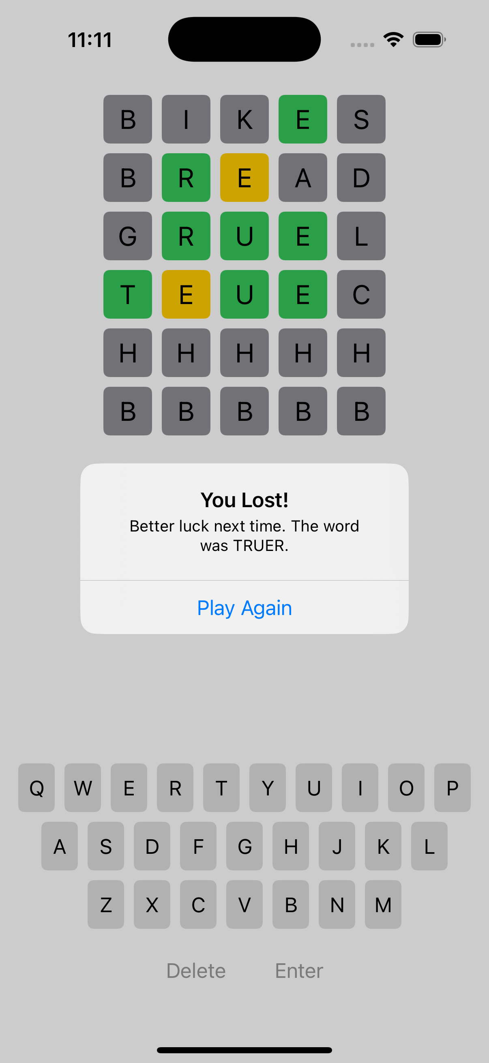
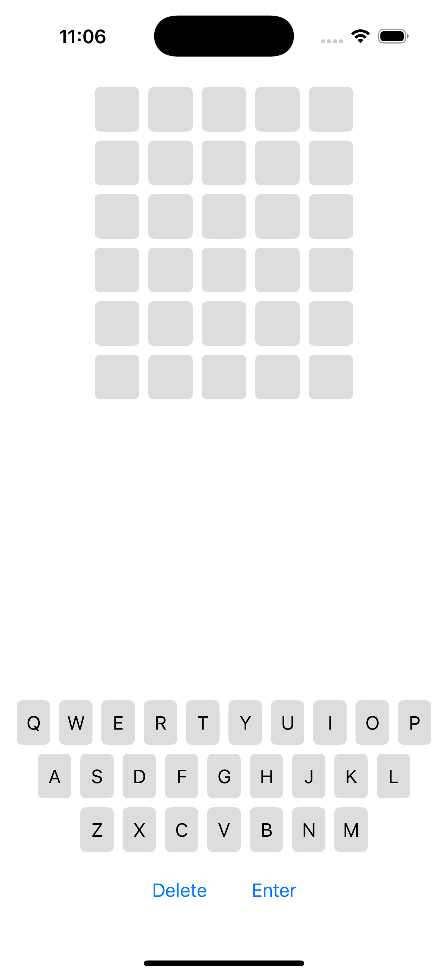
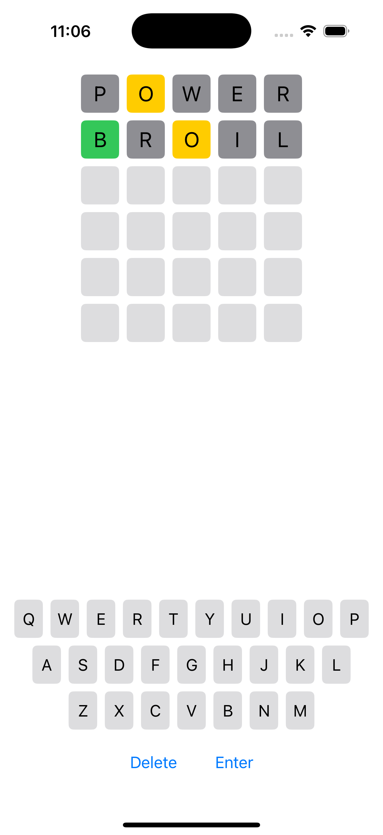
Design

Slide 6
Live Demonstration

